Slide 1
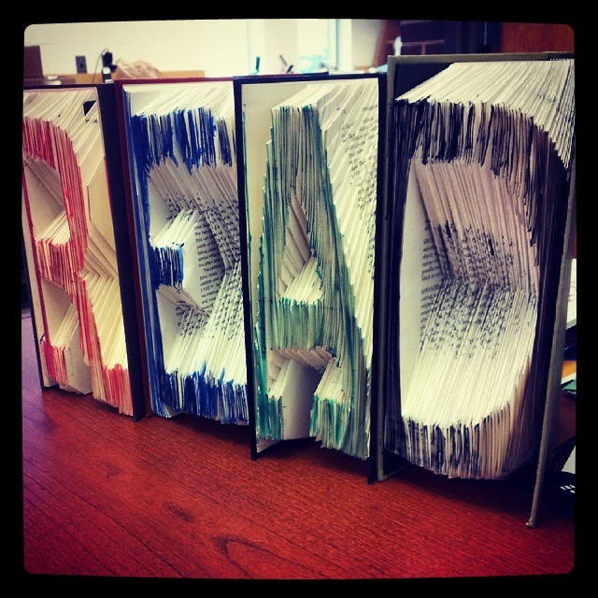
Outreach through Art:
Creating a Welcoming Space for Students
SCLA Presentation
Katie Carpenter

Slide 2
Welcome!

Slide 3
“Imitation is the sincerest form of flattery.”
― Charles Caleb Colton

Slide 4
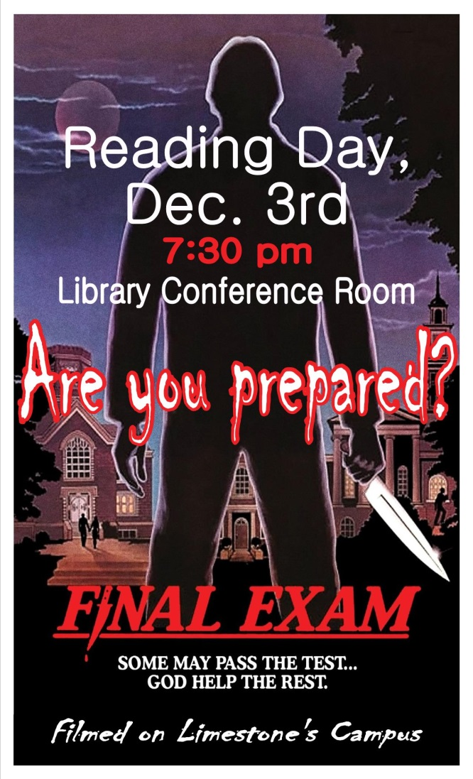
Flyers and Signage
Keep them simple yet informative
  Use hierarchy to let important information stand out
Eye catching
  Don’t be afraid to use color, different fonts, lines/shapes to separate out areas of interest
Location of flyers
  Place them where you know people will stop and read
    Bathroom stalls, doors

Slide 5

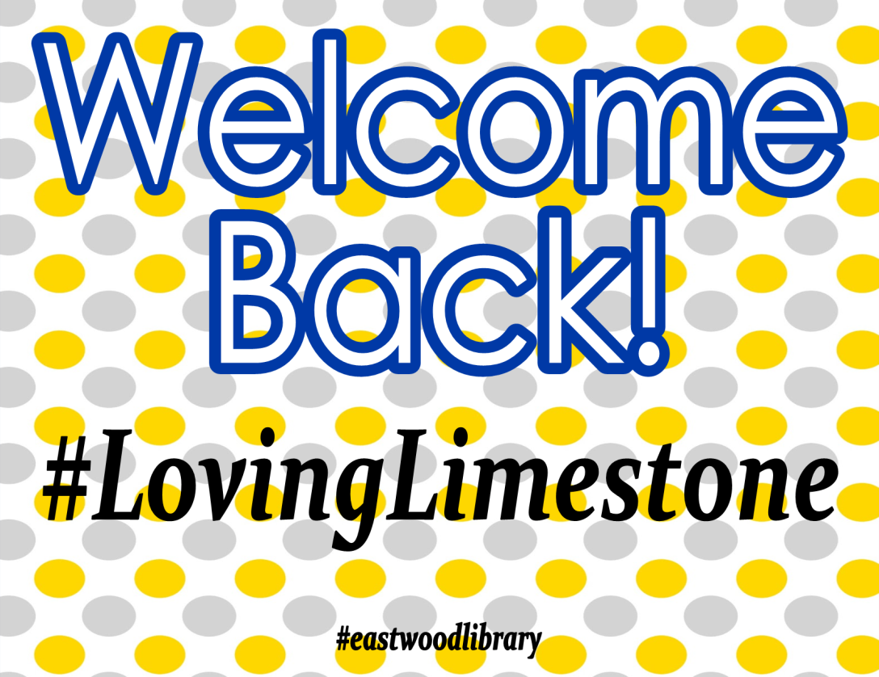
Flyers and Signage

Slide 6
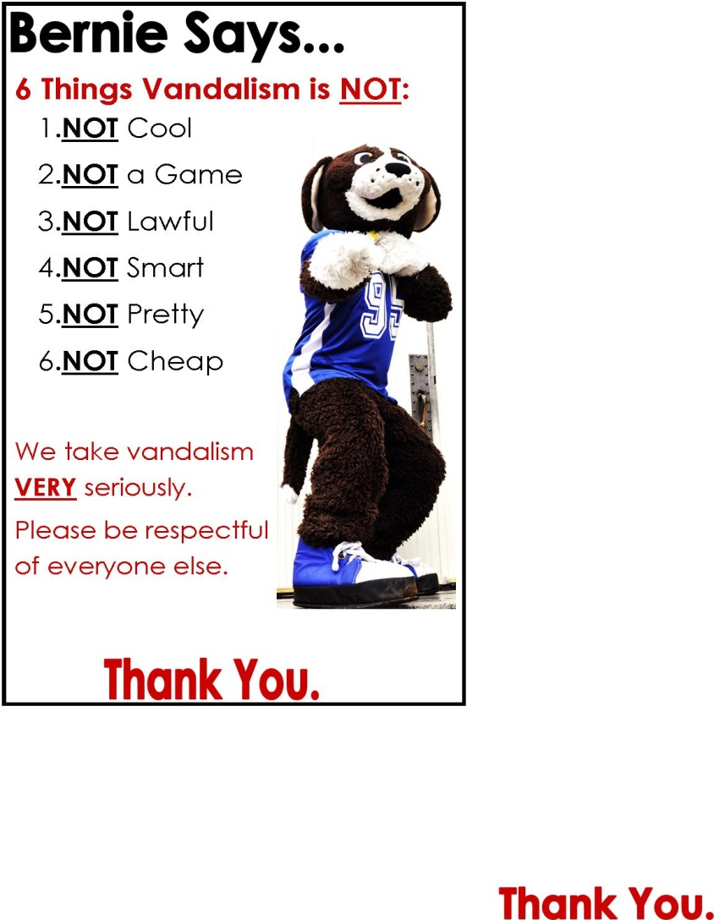
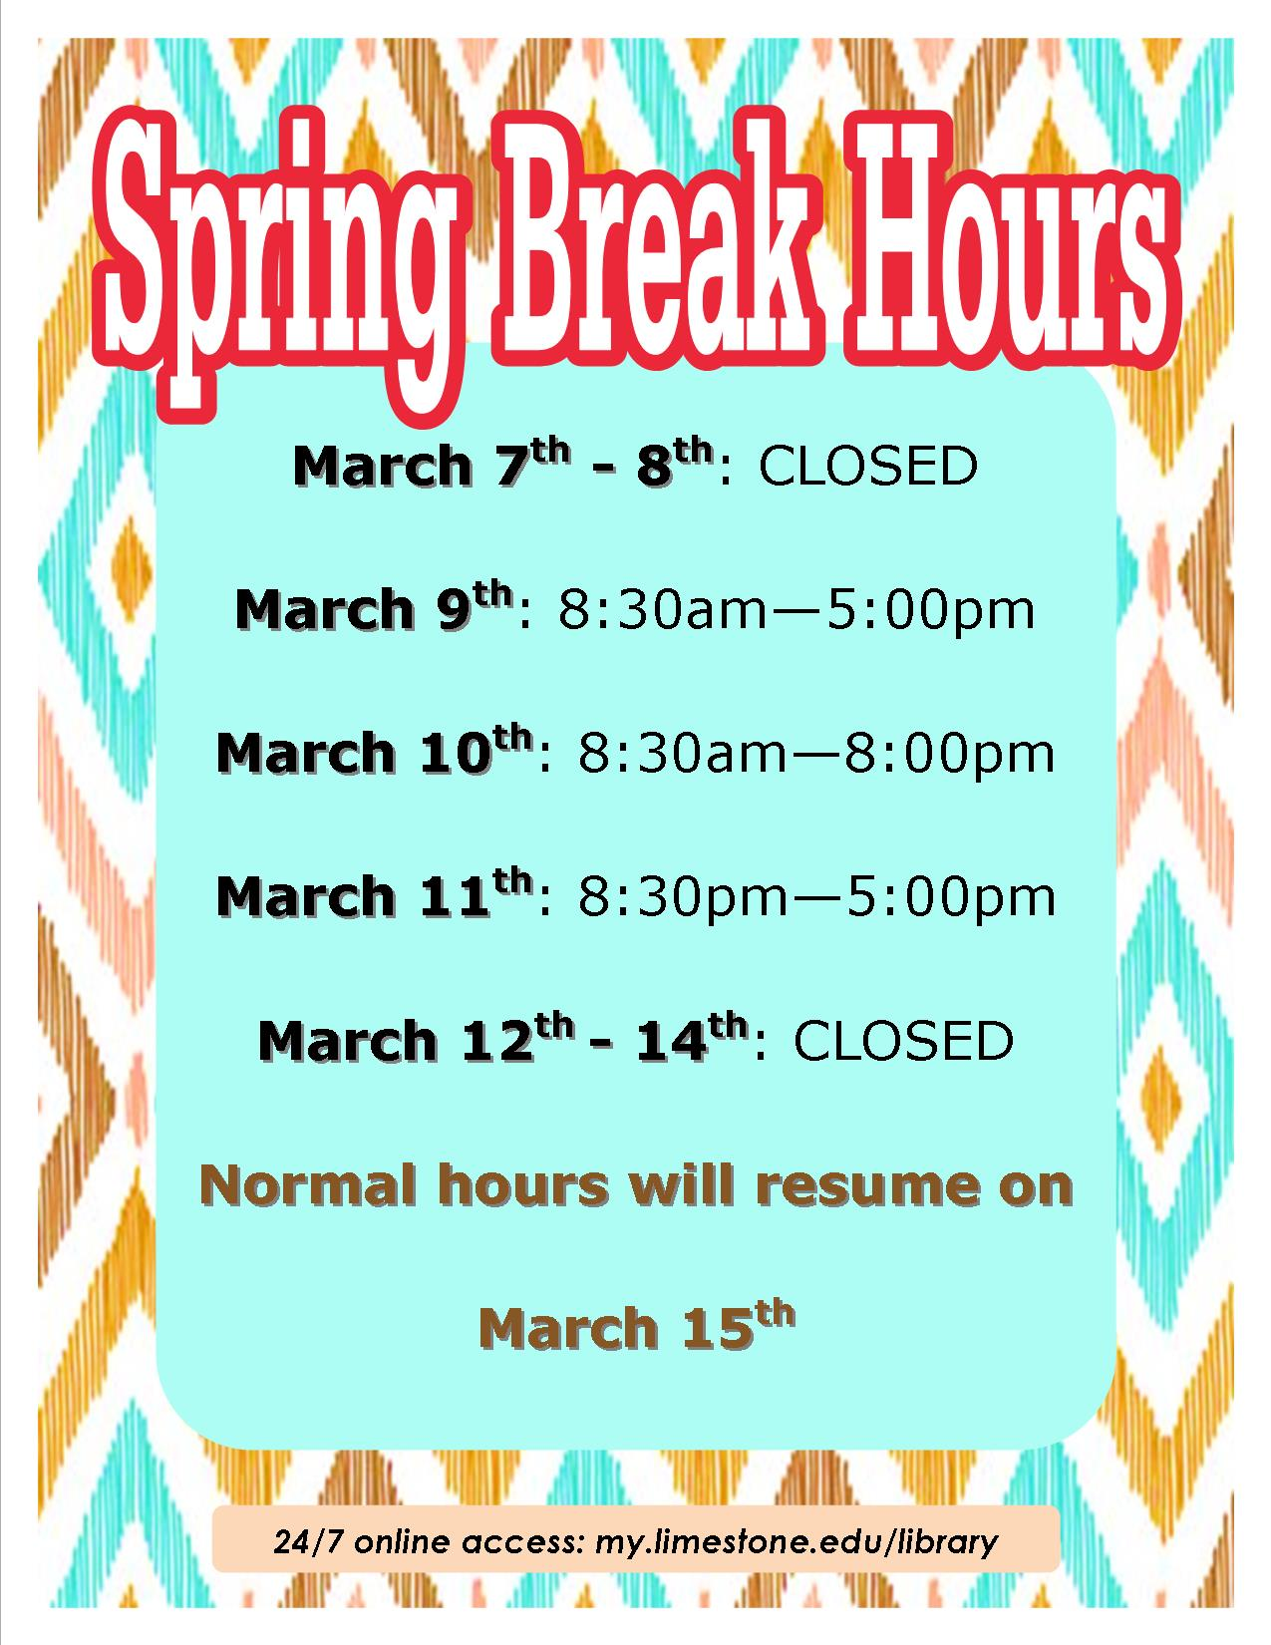
Flyers and Signage

Slide 7

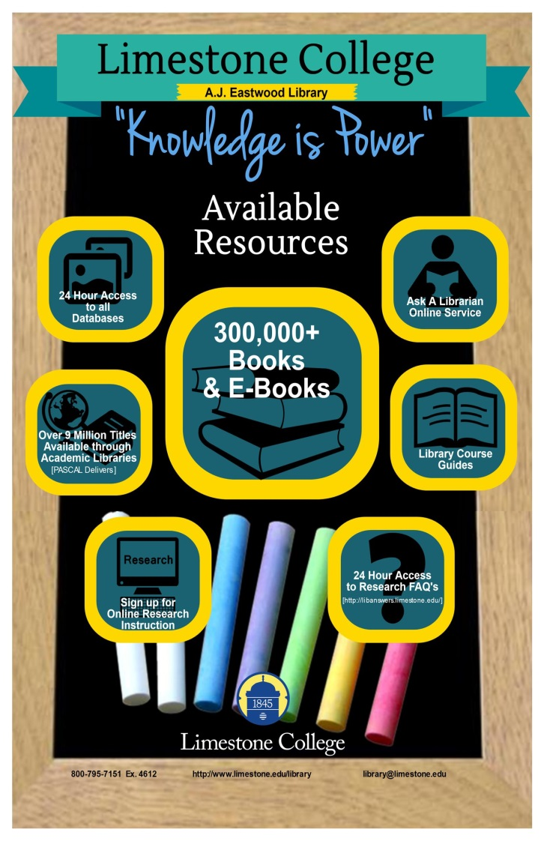
Flyers and Signage

Slide 8

Memes
Use iconic images to draw people in
Keep them short and funny
    Some people don’t want to stop and read
You can stick to a theme
  Exam week, 1st week back, holidays
http://www.memes.com/img/85371

Slide 9


Memes
http://makeameme.org/meme/welcome-back-we-02gidz
http://www.kzone.com.au/gallery/lol-jokes-back-to-school-memes

Slide 10


Memes
https://s-media-cache-ak0.pinimg.com/originals/a2/a7/8e/a2a78eff1899a97885b0429a284a2e9e.jpg
http://www.collegestack.com/blog/funny-monday-memes

Slide 11
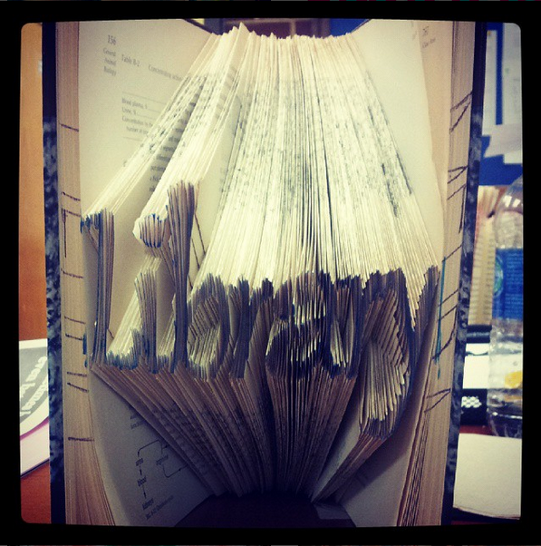
Displays
Make them eye catching from afar
    You want people to see them and come closer
Think outside the box
    Include more than books
    Draw the eyes of viewers in
Find ways to utilize unused spaces
  Use every surface you can to get people intrigued
  Don’t place the same display in the same area each time
Don’t break the bank
  Find cheap / free supplies
  Make your own decorations with what you already have
Ask other co-workers or departments for ideas
  Don’t underestimate other’s ideas

Slide 12
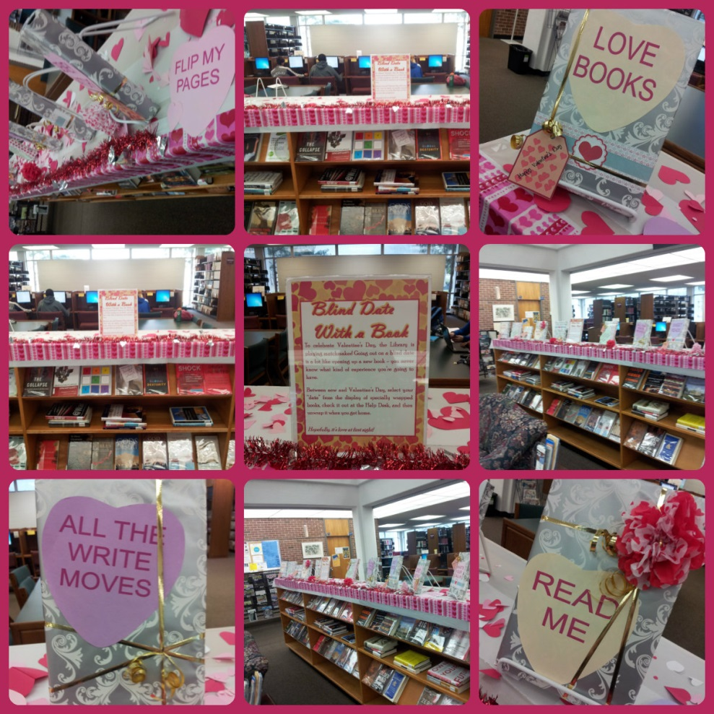
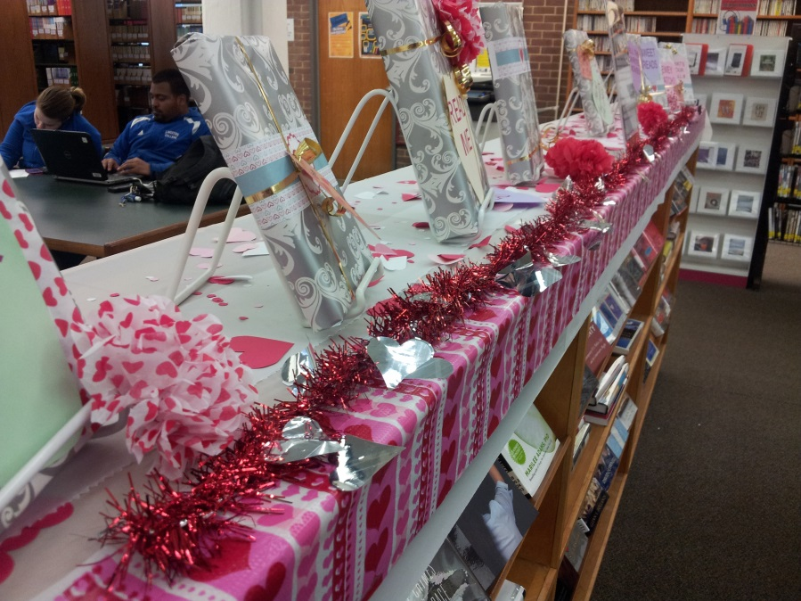
Displays

Slide 13
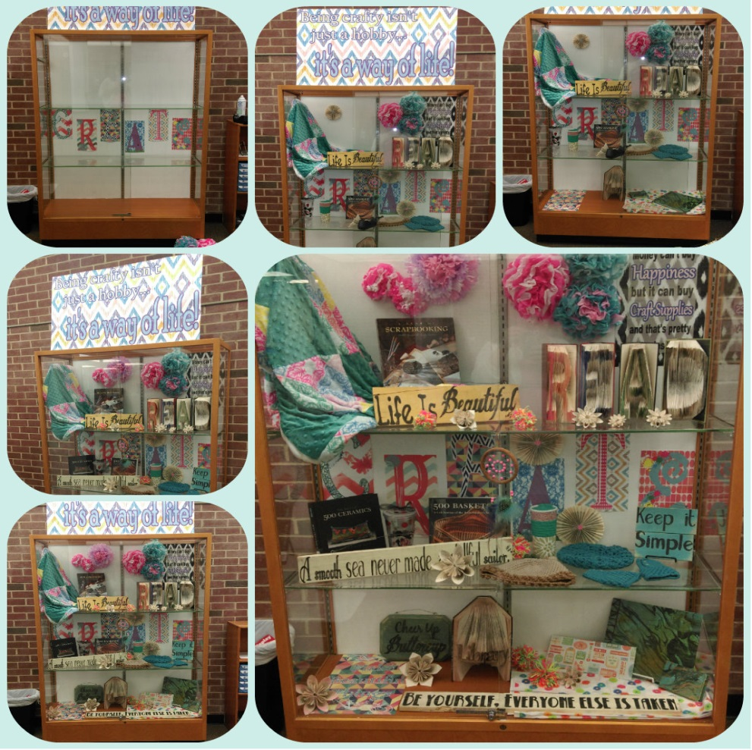
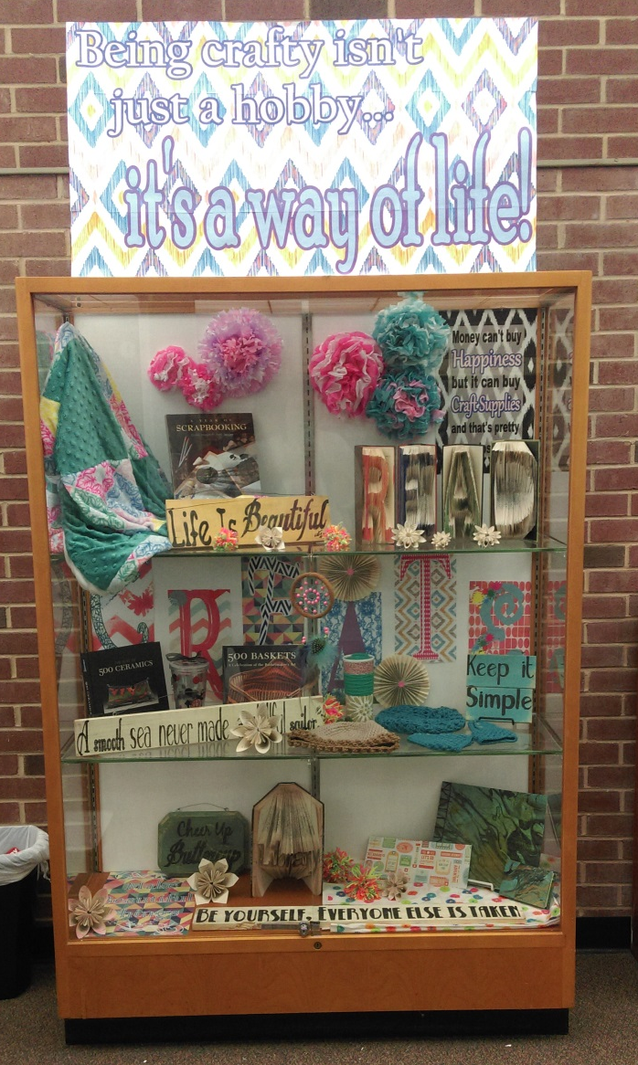
Displays

Slide 14

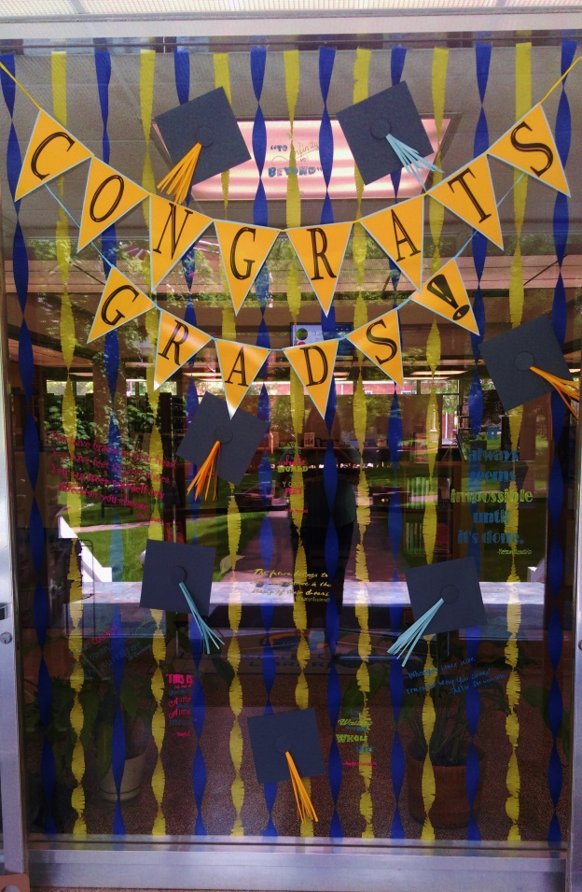
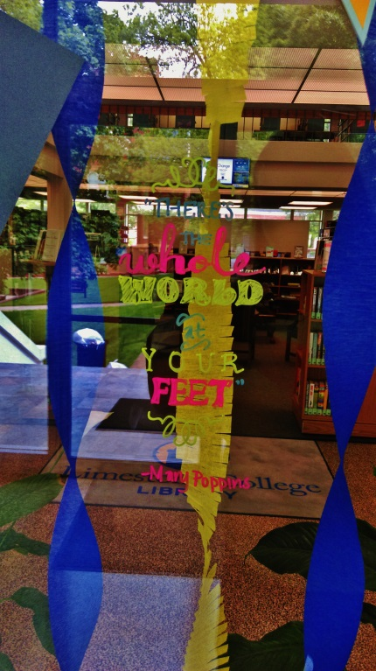
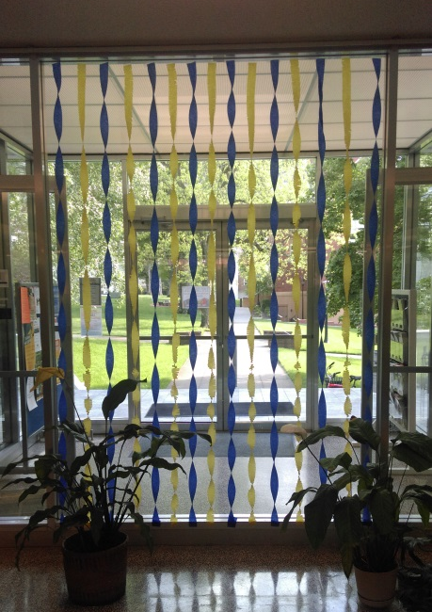
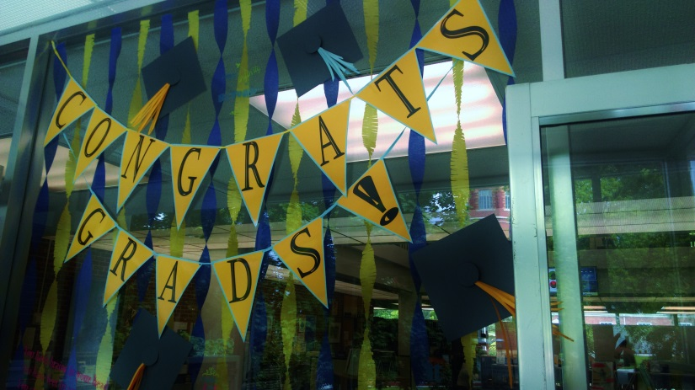
Displays

Slide 15

Displays
http://blogs.disney.com/oh-my-disney/2013/12/01/disney-quotes-to-travel-by/

Slide 16

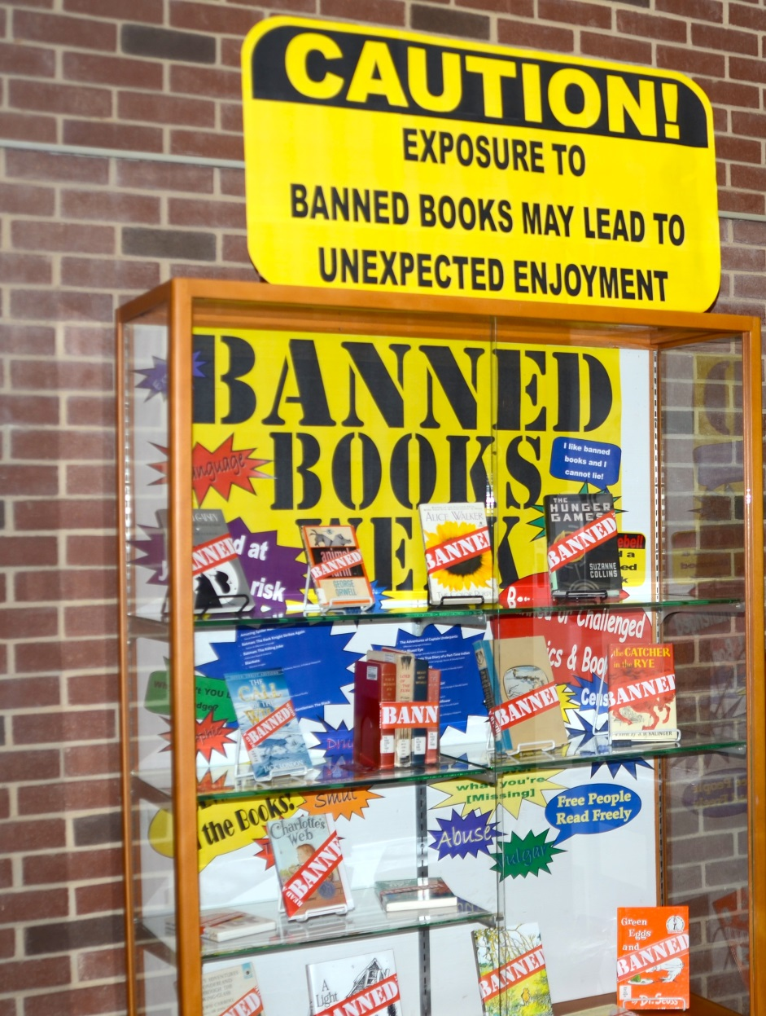

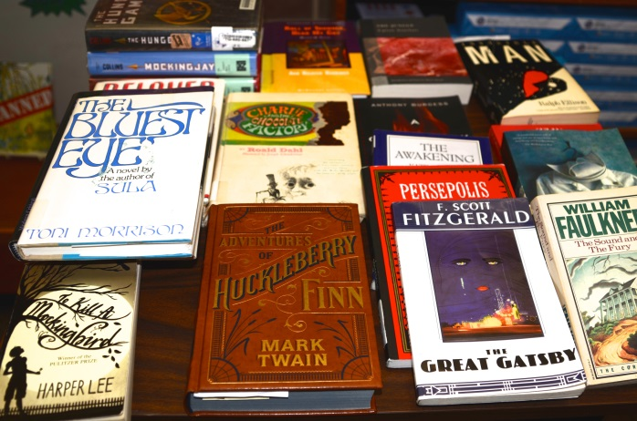
Displays

Slide 17
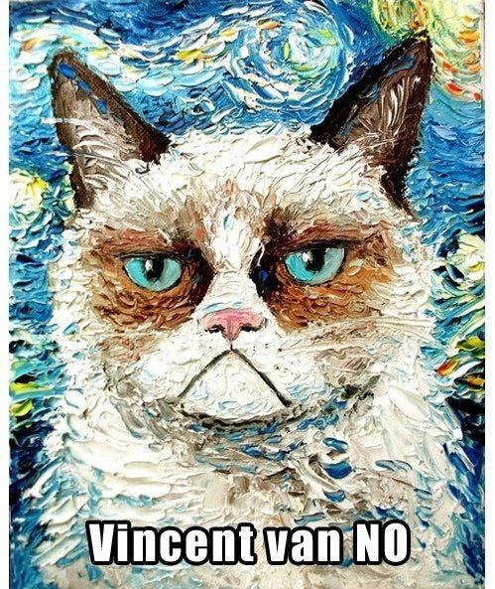
Tips & Tricks
You don’t have to be a professional artist to create great works
Find resources to use to make it easier creating flyers
  Canva – online program you can use to create flyers / posters
  Piktochart – online program to create infographics
Use Word & Publisher to quickly edit images
  Crop, Contrast, Color, Effects
Change margins in Word & Publisher to Narrow
  Sets the margins to match the printer’s margins
Change Page Size in Publisher to create larger posters / banners
  Will need to cut and tape together, but can make any size
http://www.huffingtonpost.com/2015/03/06/van-gogh-last-supper_n_6753294.html

Slide 18

Tips & Tricks
Shortcut Keys:
  Ctrl + X – Cut
  Ctrl + C – Copy
  Ctrl + V – Paste
  Ctrl + A – Select All (All type or all items on page)
  Ctrl + B – Bold Font
  Ctrl + I – Italic Font
  Ctrl + U – Underline Font
Resizing Images
  Pull from outer corners to resize
  This keeps the images proportions and won’t distort the image
Don’t be afraid to see what others are doing
  Pinterest is your friend for ideas!
  See what other libraries are doing

Slide 19
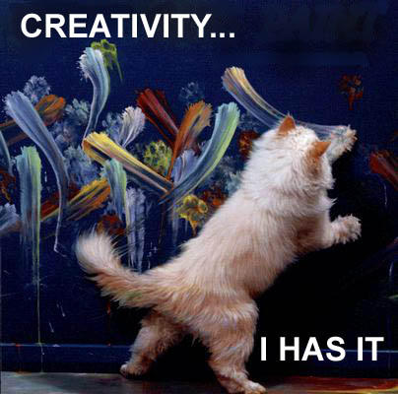
My Process
Main program: Microsoft Office Publisher
    Slight learning curve
Think about the audience you are trying to inform
    Faculty/Staff; students/patrons
    Should it be entertaining or more professional?
Determine Size
  Sign, Poster, Flyer, Display
Decide theme / colors
Just get started
  No matter how long you plan, once you start you may notice you need to do things differently
https://dropline.net/cats/kitty/creativity

Slide 20
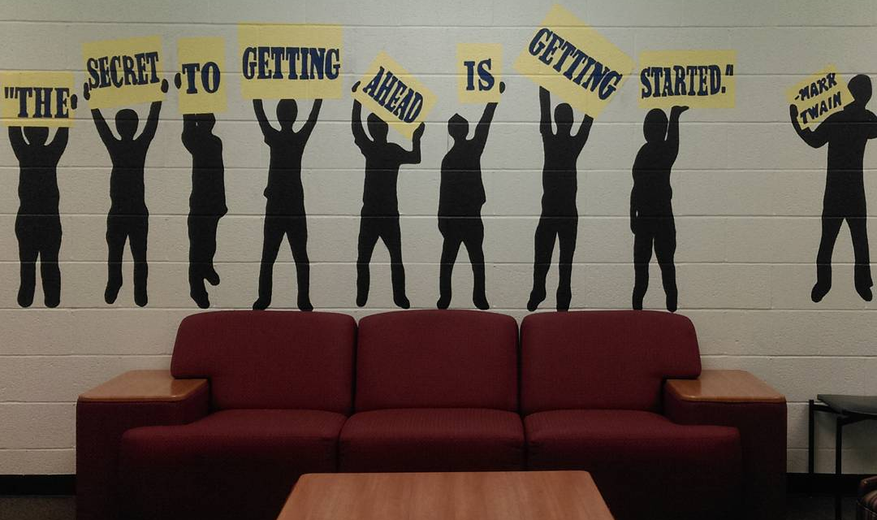
Future Ideas

Slide 21
Contact Information:
  Katie Carpenter
  Public Services Manager
  Limestone College
  Email: Kcarpenter@limestone.edu

